Slide 1

WELCOME

Slide 2
TEACHER’S PROFILE:
JOYDEB ADHIKARY
Asst. Teacher(Eng)
Dasha Palli NK High School.
ID-3

Slide 3
Class: vi
Sub: English 1st Paper,
Topic: At a railway station,
Unit: 3

Slide 4
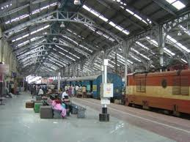
Railway Station

Slide 5
Todays lesson
“At railway station”

Slide 6
Learning out come:
By the end of the lesson students will have-
Read a text about a railway station and completed fill in the blanks.
Talked about railway station.
Write a paragraph about railway station.

Slide 7
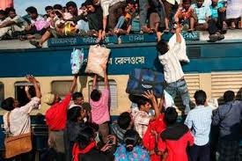
Running train is at the stop

Slide 8
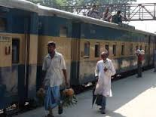
A stop train is leaviing the station

Slide 9
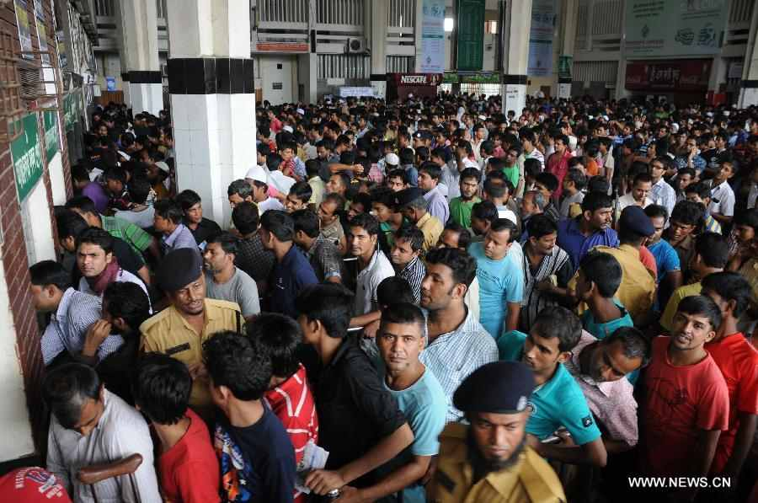
m
Lines of people at the ticket counter.

Slide 10
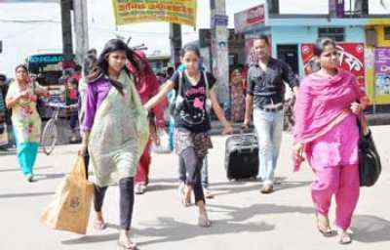
A woman holding her baby’s hand

Slide 11
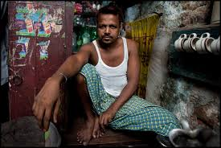
A TEA STALL

Slide 12
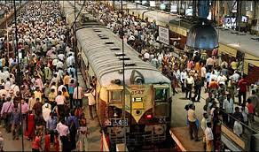
CROWDED

Slide 13

Magazine

Slide 14

Luggage

Slide 15
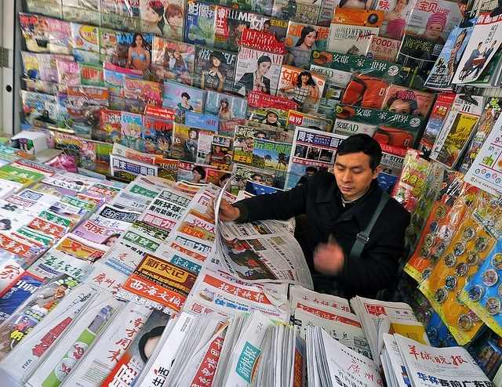
NEWSPAPER STALL

Slide 16
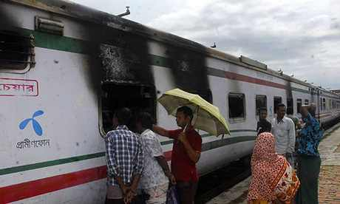
SEE OFF

Slide 17

Open at page 8 and read text silently.

Slide 18
Fill in the gaps using suitable words from the text in pairs:
My friend and (be)……………sitting at the railway station.
There(be)…………people who were talking loudly.
I saw one man who was …………..to carry one heavy suitcase.
I came to see him ……………
I stood near a ……………stall.

Slide 19
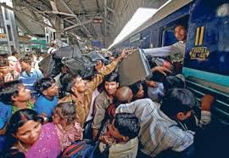
Answer the following questions in pairs. One will ask and another will answer.eg)i.What can you see in the picture? Ii)What is the boy catching? Iii)Where is train?

Slide 20
HOME WORK
Write paragraph on a railway station in 1oo words.

Slide 21

THANK YOU

